Slide 1
One Olympiad Problem
SDMC Gauss class
Instructor: David Balmin
dbalmin@gmail.com

Slide 2
One Bonus Problem: AMC 10A 2011 Problem #24
Two distinct regular tetrahedra have all their vertices among the vertices of the same unit cube. What is the volume of the region formed by the intersection of the tetrahedral?
(A) 1/12 (B) sqrt(2)/12 (C) sqrt(3)/12
(D) 1/6 (E) sqrt(2)/6

Slide 3
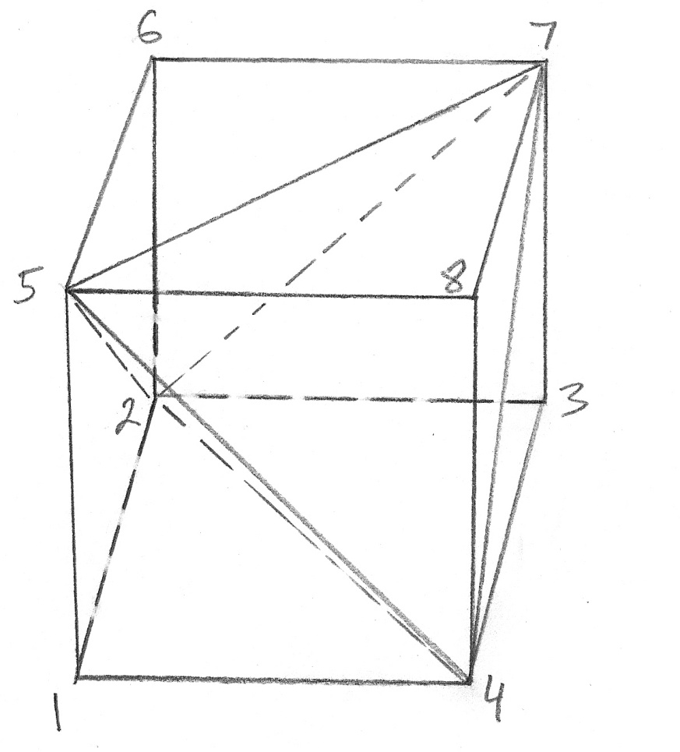
AMC 10A 2011 Problem #24

Slide 4
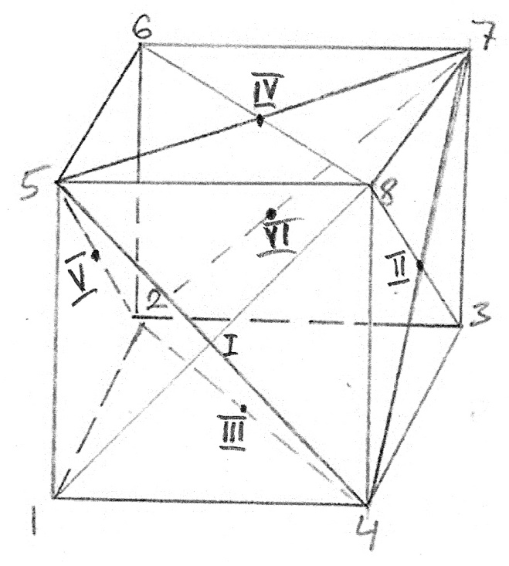
AMC 10A 2011 Problem #24

Slide 5
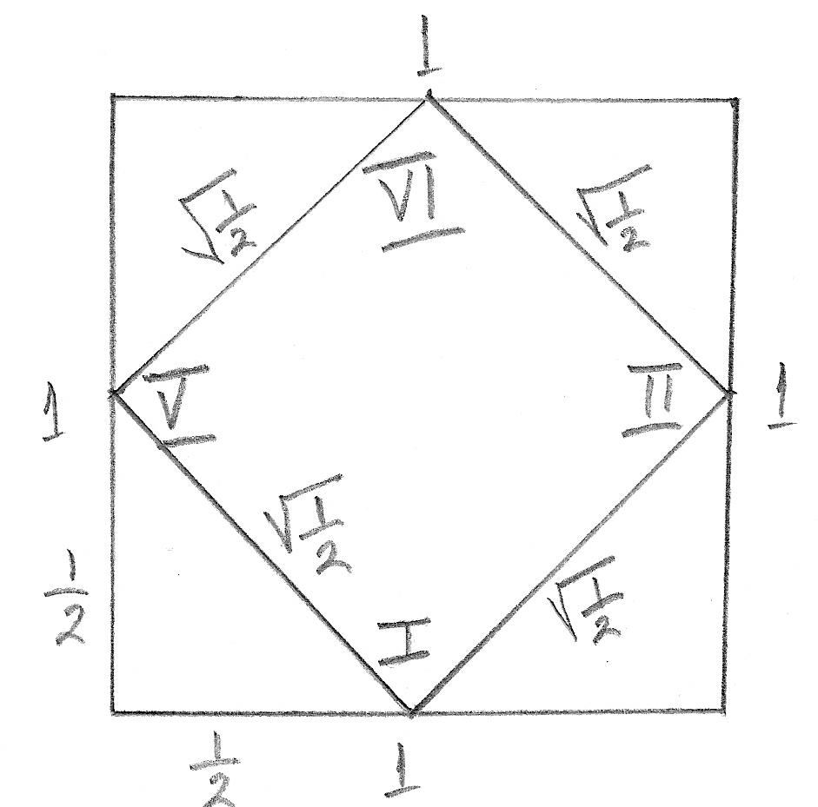
AMC 10A 2011 Problem #24

Slide 6
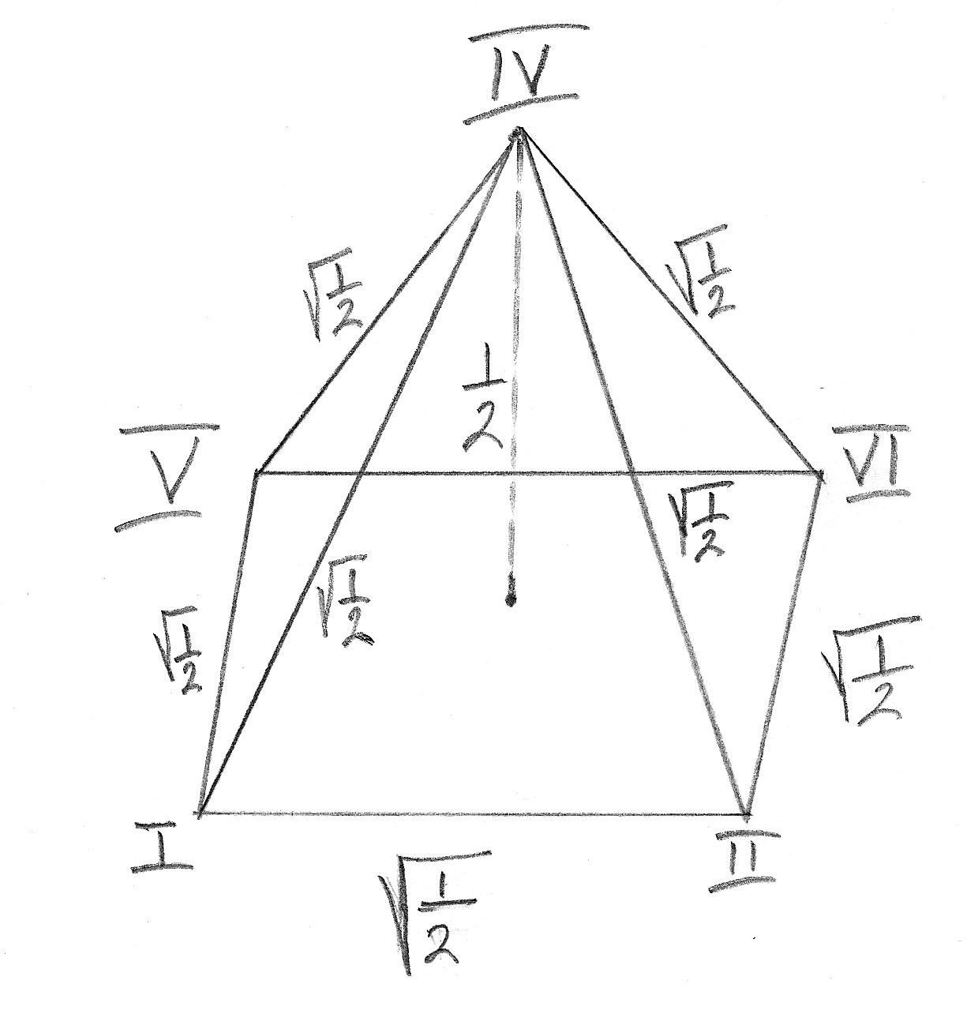
AMC 10A 2011 Problem #24

Slide 7
AMC 10A 2011 Problem #24
The area of the base of this pyramid is 1/2.
The height of this pyramid is 1/2.
The volume of this pyramid is (1/3)*(1/2)*(1/2) = 1/12.

Slide 8
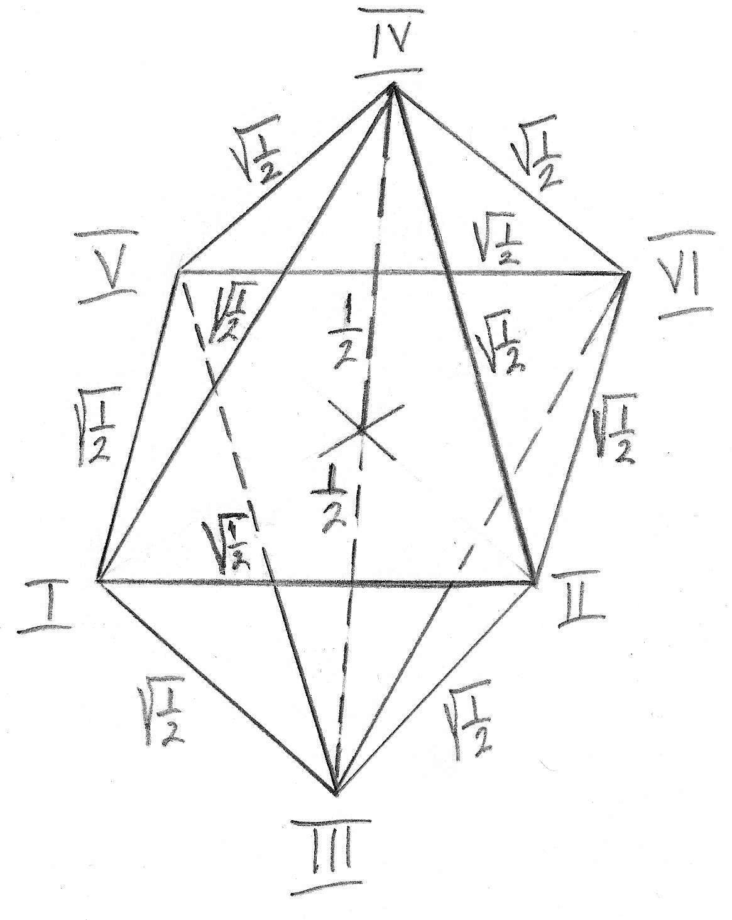
AMC 10A 2011 Problem #24

Slide 9
AMC 10A 2011 Problem #24
The volume of the intersection of two tetrahedra is 2*(1/12) = 1/6.
The answer is (D)

Slide 10
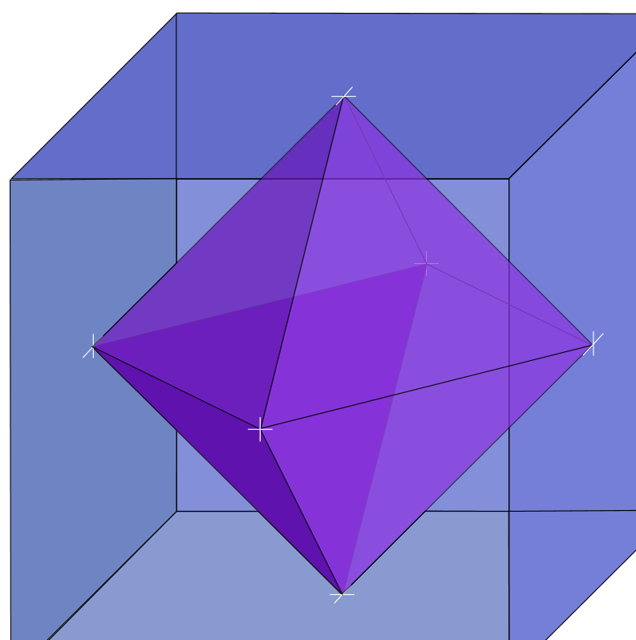
3D Graphics - AMC 10A 2011 Problem #24

